Slide 1
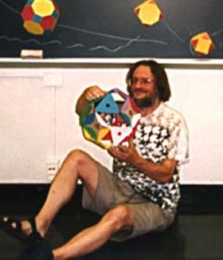
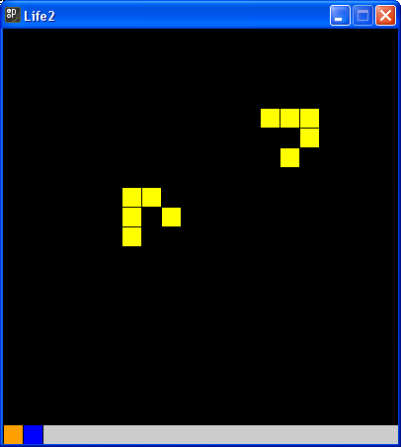
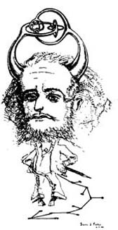
The Game of Life
The Game of Life, also known simply as Life, is a cellular automaton devised by the British mathematician John Horton Conway in 1970. It is the best-known example of a cellular automaton.
The "game" is actually a zero-player game, meaning that its evolution is determined by its initial state, needing no input from human players. One interacts with the Game of Life by creating an initial configuration and observing how it evolves. (Wikipedia)
John Horton Conway doing maths
Cartoon of John Horton Conway

Slide 2
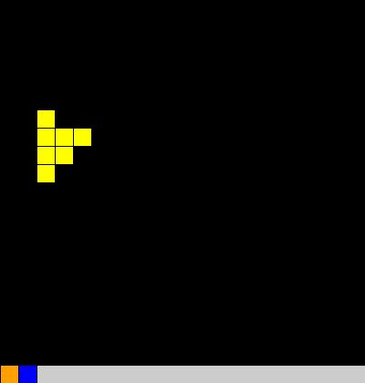
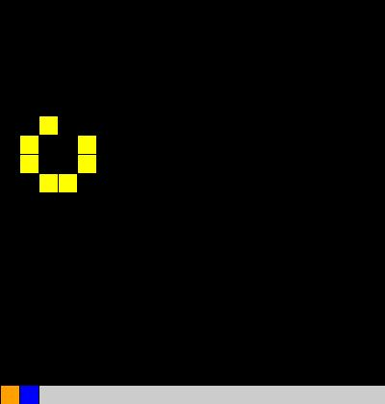
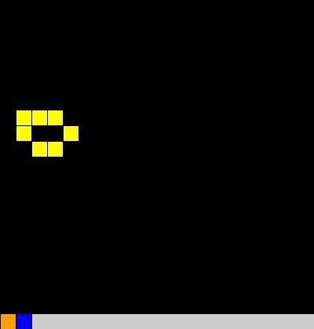
Rules
The universe of the Game of Life is an infinite two-dimensional orthogonal grid of square cells, each of which is in one of two possible states, live or dead. Every cell interacts with its eight neighbours, which are the cells that are directly horizontally, vertically, or diagonally adjacent. At each step in time, the following transitions occur:
Any live cell with fewer than two live neighbours dies, as if by needs caused by underpopulation.
Any live cell with more than three live neighbours dies, as if by overcrowding.
Any live cell with two or three live neighbours lives, unchanged, to the next generation.
Any dead cell with exactly three live neighbours becomes a live cell.
The initial pattern constitutes the 'seed' of the system. The first generation is created by applying the above rules simultaneously to every cell in the seed — births and deaths happen simultaneously, and the discrete moment at which this happens is sometimes called a tick. (In other words, each generation is a pure function of the one before.) The rules continue to be applied repeatedly to create further generations.

Slide 3
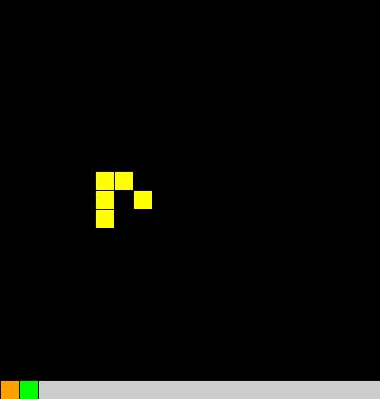
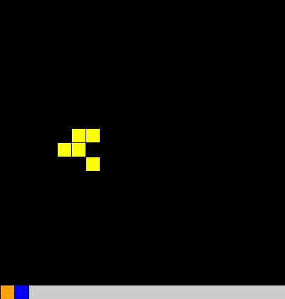
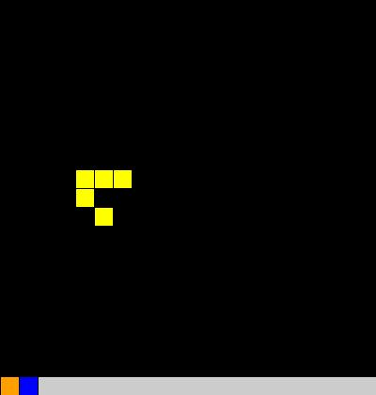
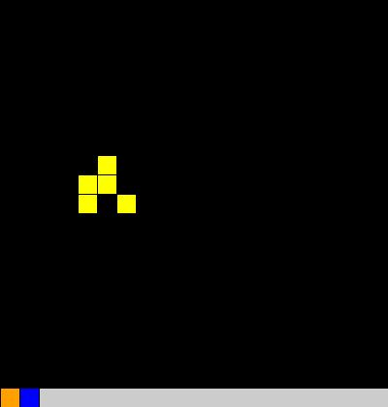
A glider returns to its initial shape after 4 moves but having moved

Slide 4
I am going to have an 2D array of Square objects, coloured Yellow for on and Black for off.
F
F
F
F
F
F
F
F
F
F
F
F
F
F
F
F
F
F
F
F
F
F
F
F
F
F
T
F
F
F
F
F
T
T
F
F
F
T
F
T
F
F
F
F
F
F
F
F
I map the colour data into boolean form. From the boolean array I can reconstruct the Squares array and vice versa. They are isomorphic (same form or ‘shape’).
If I try and update this without saving the information then I shall lose information before I have fully updated this.

Slide 5
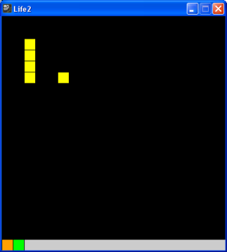
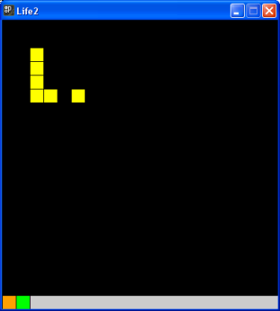
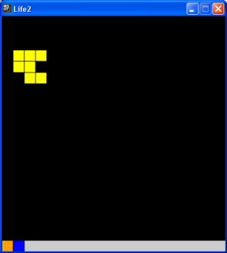
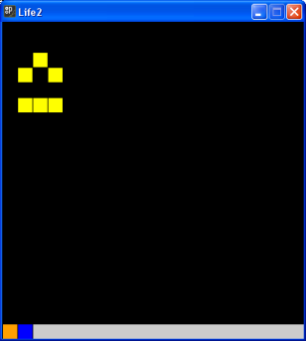
Let’s think about the structure of this program.
It will be event driven in two aspects.
Firstly in setting up the initial configuration.
Secondly in moving from state to state of the ‘history’.

Slide 6
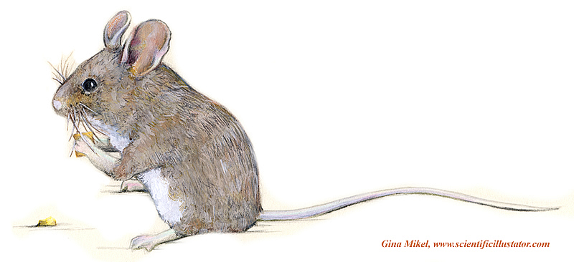
Set up State
Move State

Slide 7
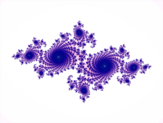
We shall approach this problem incrementally
Life1_1 will set up the basic board and buttons but with no functionality
Life1_2 will allow us to choose squares for our Life experiment
Life1_3 will give the functionality for updating the boolean values in the array
Life1_4 concludes by letting us update the display to the next Life generation.

Slide 8
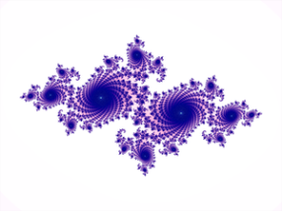
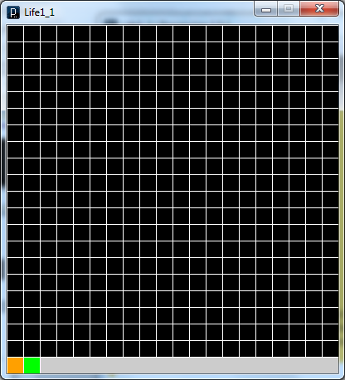
Programme Structure Life 1
Life1_1 will set up the basic board and buttons but with no functionality
Processing
setup()
draw()
Square()
DrawBoard()
Flip.Draw()
Action.Draw()
Square.Draw()
Flip
Action

Slide 9
int SquareSide = 20;//Side of individual squares
int Rank = 20;// Number of squares per side
int Side = SquareSide * Rank; // Clearly the width and height of the canvas
color White = color(255, 255, 255),
Yellow = color(255, 255, 0),Green = color(0, 255, 0),
Blue = color(0, 0, 255),
Orange = color(255, 160, 0),
Black = color(0);
// A board is a set of locations, here squares
Square[][] Board = new Square[Rank][Rank];
// The isomorphic boolean array
boolean[][] Q_States = new boolean[Rank][Rank];
// Control buttons
Square Flip = new Square(SquareSide/2, Side + SquareSide/2, SquareSide, Orange, White),
Action = new Square(3 * SquareSide/2, Side + SquareSide/2, SquareSide, Green, White);
// Initially the system is not ready to run
boolean Q_Run = false;
void setup() {
int i,
j;
size(Side, Side + SquareSide);
for(i = 0; i < Rank; i++) {
for(j = 0; j < Rank; j++) {
//All squares are initially black
Board[i][j] = new Square(i * SquareSide + SquareSide/2,
j * SquareSide + SquareSide/2, SquareSide, Black, White);
Q_States[i][j] = false;// all booleans are initially false
}
}
}
F
F
F
F
F
F
F
F
F
F
F
F
Initial state of Board and Q_States
F
F
F
F
F
F
F
F
F
F
F
F
F
F
F
F
F
F
F
F
F
F
F
F
F
F
F
F
F
F
F
F
F
F
F
F

Slide 10
void DrawBoard() {
int i,
j;
for(i = 0; i < Rank; i++) {
for(j = 0; j < Rank; j++) {
Board[i][j].Draw(); // draw the board cells using the
} // Square Draw method
}
}
void draw() {
DrawBoard();
Action.Draw();//draw the buttons using the Square Draw method
Flip.Draw(); //
}

Slide 11
class Square {
int xC,
yC;
int Side;
color FillCol,
EdgeCol;
public Square(int xC, int yC, int Side, color FillCol, color EdgeCol) {
this.xC = xC;
this.yC = yC;
this.Side = Side;
this.FillCol = FillCol;
this.EdgeCol = EdgeCol;
}
public void Draw() {
fill(FillCol);
stroke(EdgeCol);
rectMode(CENTER);
rect(xC, yC, Side,Side);
}
public boolean Q_Contains(int x, int y) {
return((x >= xC - Side/2) && (xC + Side/2 > x) &&
(y >= yC - Side/2) && (yC + Side/2 > y));
}
}
Side
(xC, yC)
Side

Slide 12
Programme Structure Life 2
Life1_2 will allow us to choose squares for our Life experiment
Processing
setup()
draw()
mousePressed()
Square()
UpdateBoard()
UpdateState()
DrawBoard()
Flip.Draw()
Action.Draw()
FlipSquare
UpdateBooleans()
UpdateDisplay()
Square.Draw()
Get_SquareClicked()
S.Q_Contains()

Slide 13
void mousePressed() {
if (Flip.Q_Contains(mouseX, mouseY)) {// Flip flips between set up and run
UpdateState();
}
else {
UpdateBoard();// update the whole board
}
}
void UpdateBoard() {
if (!Q_Run) {
FlipSquare();
}
else {
//UpdateBooleans();
//UpdateDisplay();
}
}
Not yet implemented

Slide 14
void FlipSquare() {
Square S;
S = Get_SquareClicked();
if (S != null) {
if (S.Col == Yellow) {
S.Col = Black;
}
else {
S.Col = Yellow;
}
}
}
// If a square on the board has been clicked
// returns that Square
// Else
// returns null
Square Get_SquareClicked() {
Square S;
int i,
j;
for(i = 0; i < Rank; i++) {
for(j = 0; j < Rank; j++) {
S = Board[i][j];
if(S.Q_Contains(mouseX, mouseY)) {
return(S);
}
}
}
return(null);
}

Slide 15
Programme Structure Life 3
Life1_3 will give the functionality for updating the boolean values in the array
Processing
setup()
draw()
mousePressed()
Square()
UpdateBoard()
UpdateState()
DrawBoard()
Flip.Draw()
Action.Draw()
FlipSquare
UpdateBooleans()
UpdateDisplay()
Square.Draw()
Get_SquareClicked()
S.Q_Contains()

Slide 16
// Map the Square array on to the boolean array thus saving info
void UpdateBooleans() {
int i,
j;
for(i = 0; i < Rank; i++) {
for(j = 0; j < Rank; j++) {
if (Board[i][j].Col == Black) {
Q_States[i][j] = false;
}
else {
Q_States[i][j] = true;
}
}
}
}

Slide 17
Programme Structure 4
Life1_4 lets us update the display to the next Life generation.
Processing
setup()
draw()
mousePressed()
Square()
UpdateBoard()
UpdateState()
DrawBoard()
Flip.Draw()
Action.Draw()
FlipSquare
UpdateBooleans()
UpdateDisplay()
Square.Draw()
Get_SquareClicked()
S.Q_Contains()

Slide 18
void UpdateDisplay() {
int i,
j;
int Code;
for(i = 0; i < Rank; i++) {
for(j = 0; j < Rank; j++) {
Code = get_Code(i, j); //get_Code tots up how many neighbours square (i, j) has
// Updates the board according to the boolean array and the value of Code
if (Q_States[i][j]) {//square is currently yellow
if (Code < 2 || 3 < Code) {
Board[i][j].Col = Black;// Cell dies of loneliness or overcrowding
}
}
else {//square is currently black
if (Code == 3) {
Board[i][j].Col = Yellow;//Black cell turns Yellow
}
}
}
}
}
C
C
C
Lonely
Overcrowded
New Cell
C
C
C

Slide 19
// Counts up the neighbouring states
int get_Code(int x, int y){
int i,
j;
int Sum = 0;
for (i = -1; i < 2; i++) {
for(j = -1; j < 2; j++) {
if (i!=0 || j!= 0) { //Don’t count C itself
// Use of modulus operator % enables 'wrap around'
if (Q_States[(i + x + Rank) % Rank][(j + y + Rank) % Rank]){
Sum++;
}
}
}
}
return(Sum);
}
C is touching 5 live cells
C

Slide 20
Programme Structure 5
Life1_5 concludes by letting us have a random set up facility.
Processing
setup()
draw()
mousePressed()
DoRandomSetUp()
Square()
UpdateBoard()
UpdateState()
DrawBoard()
Flip.Draw()
Action.Draw()
FlipSquare
UpdateBooleans()
UpdateDisplay()
Square.Draw()
Get_SquareClicked()
S.Q_Contains()

